Slide 1
Barone2
Spring Design Progress Review 2
Dylan Harootunian
Chin Ming Ryan Wong
Leonid Shuster
Jeremy Germenis
George Hernandez
Isaac Szu

Slide 2
Project Progression is Bottlenecked Due to Unforeseen Delays in Shipping/Logistics
Fabrication Progression
Envelope fabricated and being tested but is not in a good condition
Most 3D parts printed (delayed due to issues with 3D printers)
PCB ready to be soldered (delayed from shipping times)
2nd PCB waiting on first PCB feedback (delayed due to fabrication bottleneck)
Software Progression
Inputs from remote controller receiver are being read by the Raspberry Pi, and can forward them to the PIC32 to move servos and motors, but servos and motors are not yet configured to be controlled directly by the remote controller
Closed loop RC completed and being imported into simulation for testing
Noisy sensors implemented in simulation
Conclusion: Project progression has slowed/stalled in many areas, due to shipping delays and hardware being split among team members, and while drone remote control is recoverable and expected, autonomous control is now only expected in simulation.
Notes:
Tanner pointed out 12V and 5V rail trace width need to be addressed
Remote controller positions servos and motors for three basic maneuvers (forwards/backwards, up/down, left/right)

Slide 3
Fabrication Major Milestones
Fabrication Milestones have not been met, due to 3D printing issues and shipping/logistics issues
Fabricate Drone Prototype Due 4/26: Late Expected 5/14
Envelope Fabricated and tested
Electronics need to be added blocked by PCB shipping delays
Assemble and test PCB V1.9 Due 4/26: Late Expected 5/12
Cannot be assembled or tested due to shipping delays
Parts have finally arrived and will be soldered and tested by 5/12
Valid Test data from flight test Due 5/17: Expected 5/21
Testing can not occur until Fabrication is complete and will delay flight tests
Lab access for delaware has been granted
Conclusion: All parts related to PCB are now received and fabrication should be able to continue with a remote test anticipated by May 21st. Autonomous control is now a stretch goal as we do not anticipate time to set up both autonomous and remote physical tests.

Slide 4
Software Major Milestones
Implement remote controller control of servos and motors: Incomplete, in progress, expected 5/10
Had difficulties in establishing communication between Raspberry Pi and remote controller receiver caused delay in remote controller usage, but was resolved
Currently working on remote controller positioning servos and motors for basic inputs (forwards/backwards, up/down, left/right)
Implement autonomous control of servos and motors: Incomplete
Delayed because of remote controller implementation
Now only expected to be done in simulation
Closed Loop RC design: Complete
Closed Loop RC design implemented in V-rep simulation: Incomplete. Expected 5/14/21
Auxiliary Functions Designed: Complete
Conclusion: Software progression is behind, and remote control is recoverable, but autonomous will likely not make it to physical testing.

Slide 5
Power Management Subteam is Slightly Delayed
The following tasks will be presented in detail as forthcoming slides:
Upcoming Milestone: Compare motor and servo power with estimates Late 4/30, expected 5/10, Delayed due to delivery issues
Other Tasks:
Create low pass filter for switching regulators Complete
Identify method for battery percentage monitoring Complete
Trace width calculation used as guideline for PCB Complete
Conclusion: The design considerations for the management of power is finalized, but will need to be tested with the prototype during and after fabrication to improve efficiency for stretch goal V2.0 PCB.

Slide 6
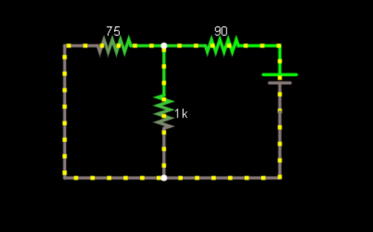
Voltage Divider Circuit Allows Tracking of Battery Voltage and Percentage Through the RC Receiver
Complete
Goal: Find a way to track the battery voltage from 9.6V-12.6V through the RC receiver
Battery voltage is above receiver operating voltage of 4-6.5V, tested internal resistance Rin = 75 ohms
R1 = 90 ohms and R2 = 1k ohms for the voltage divider based on the minimum 9.6V needing to be converted to 4V:
Vbat | Vin | P(Lost to R1&2)(mW)
9.6(0%) | 4.19 | 341
11.1(50%) | 4.84 | 454
12.6(100%) | 5.50 | 580
Simulated receiver circuit using Falstad
Vin
Rin
R1
VBat
R2
Conclusion: By setting the max and min voltages to 4.19V and 5.50V on the RC controller settings, we can accurately see the battery percentage on the controller screen that is detected by the RC receiver

Slide 7
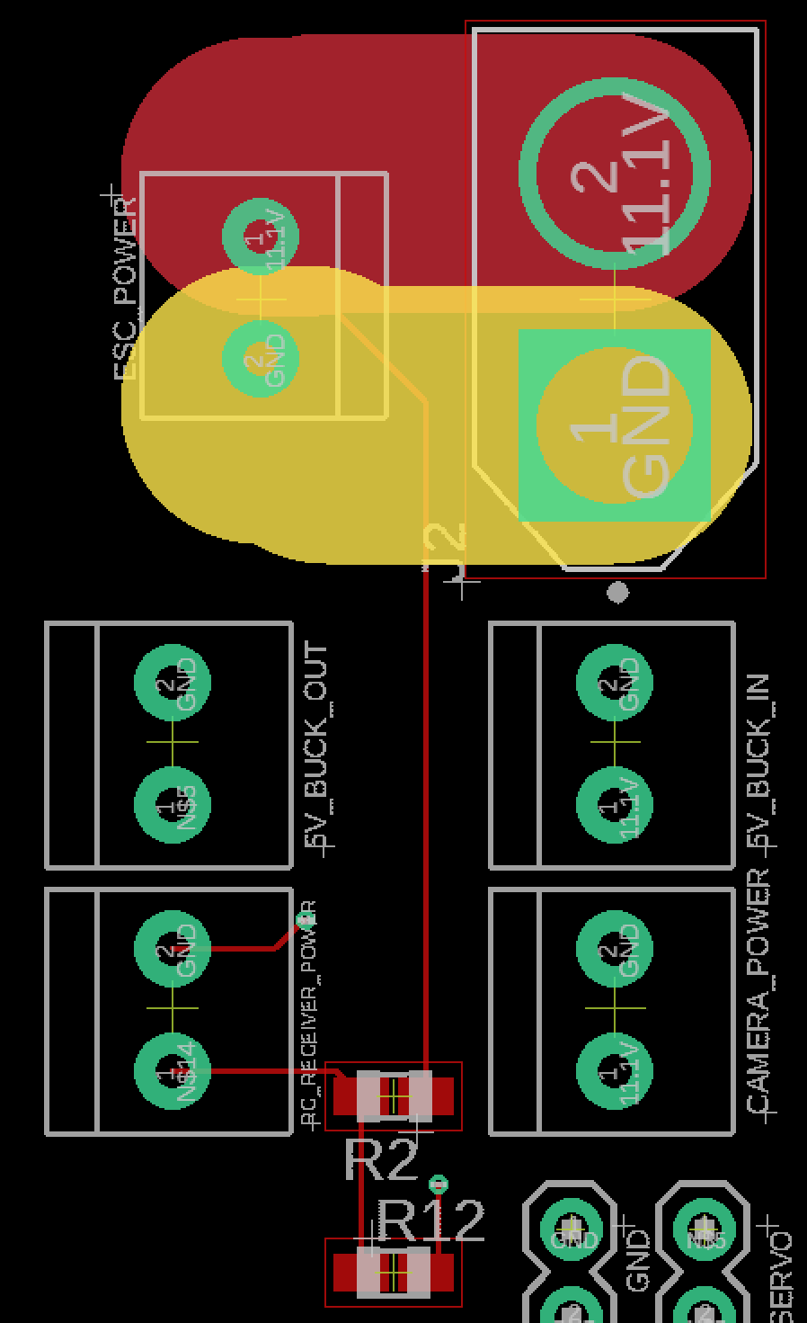
Voltage Divider Implemented in V2.0 PCB
V2.0
Goal: Voltage divider of RC receiver implemented in V2.0 PCB
78mA max, 6 mil trace width
R2 = 91 ohm
R12 = 1k ohm
Conclusion: RC receiver can detect battery voltage.
78mA, 6 mils
91 ohm
1k ohm
Figure. Voltage divider of RC receiver

Slide 8
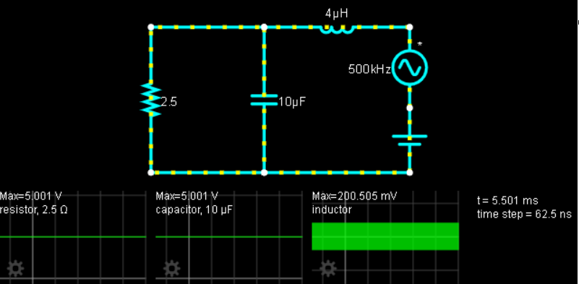
Using a Low Pass Filter Eliminates Most of the Voltage Ripple from the Switching Regulators
Complete
Goal: Minimize voltage ripple to within 1mV from the target voltage
Switching frequency of regulator = 500khz
5V rail shown divided by 1950mA max rail current makes the load resistance = 2.5 ohms
Regulator is rated for +-4% ripple from output voltage, meaning .2V AC plus 5V DC
Simulator shown reduces 200mV ripple to .5mV, 99.75% decrease, while also allowing 100% of DC 5V
Other voltage rail ripples of 1.8V and 3.3V are also reduced 99% by this filter
Simulated Circuit in Falstad with steady state voltages
.2V
Conclusion: This low pass filter of 4uH and 10uF will be used on each voltage rail, due to same model of voltage regulator, to reduce ripple on output voltage by 99% and under 1mV error from target
5V

Slide 9
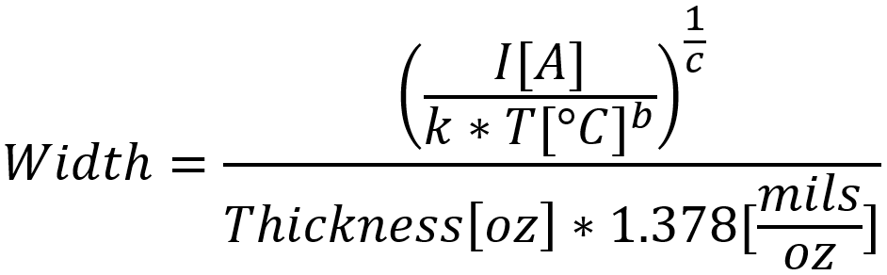
Guideline for PCB Trace Width
Goal: Show how trace width is calculated using the formula shown in equation 1.
Equation sourced from 4pcb.com board house
Constants k, b, c, follows Generic Standard on PCB
IPC-2221 (Generic Standard on PCB) constants:
k = 0.024
b = 0.44
c = 0.725
Constants derived from IPC-2221 curves
Only use trace width formula as a guideline
Conclusion: Trace width formula cannot be verified but is suggested by board house.
Trace width formula

Slide 10
Fabrication Process Progression is Delayed
The following tasks involving mechanical design progression will be presented in detail as forthcoming slides:
Milestone:
Fabrication of prototype due 4/26 : Late, expected 5/14
Envelope fabricated and inflation tests conducted but shape is not correct
3D parts mostly printed awaiting electronics to be assembled
PCB soldering has not been completed due to shipping delays
Valid test data collected from first flight test Due 5/17: Likely to be Delayed to 5/21
Data collection at Delaware St cannot be completed until fabrication is complete.
Conclusion: The fabrication process has fallen behind due to logistical issues as well as 3D print problems. The extra time gained due to delays have been spent doing extra tests on the envelope to help correct the shape which is far too tall. Testing at the flight room at 2300 Delaware St cannot occur until fabrication is complete.

Slide 11
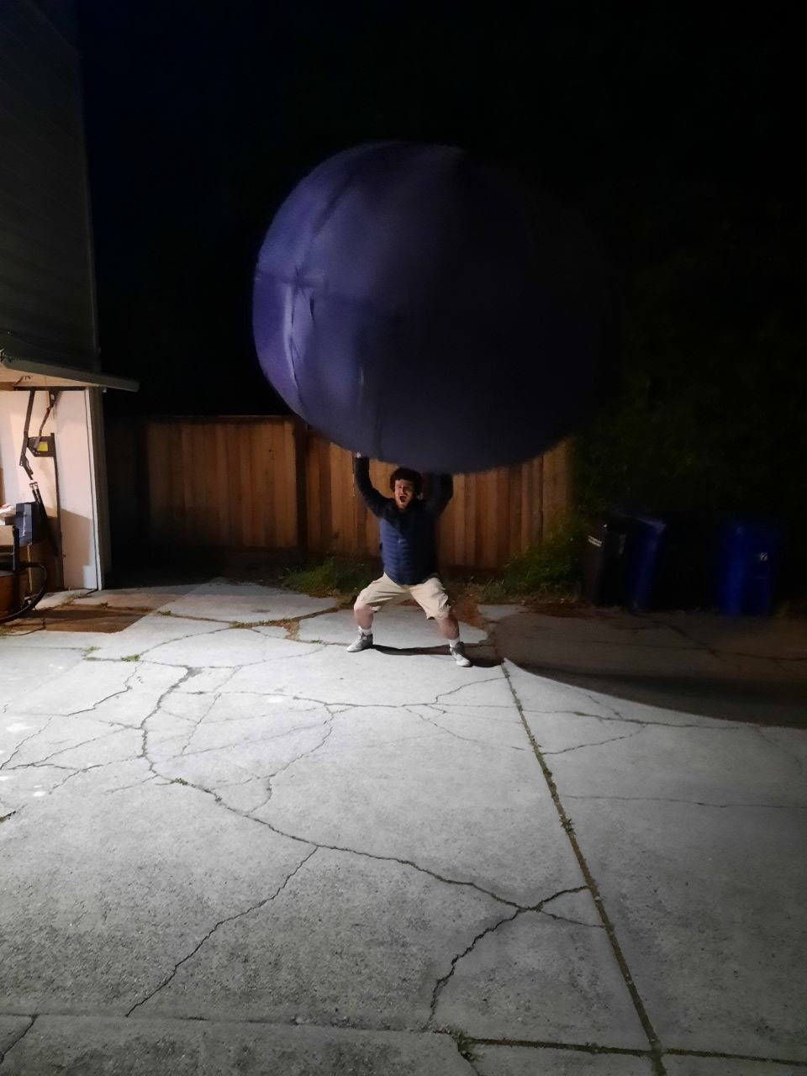
Moderate Error was Found in First Envelope Inflation Test
Validating
Requirement: Envelope shall be 108x108x40” in order to reduce drag, while maintaining around 4m³ volume
Acceptable error: Hight can be no more than ⅔ of length since the drag will be too high
Volume cannot be smaller than 3.8m³
Using circumference measurements of the envelope V1.0 measured with a string and tape measure to calculate the diameters of the envelope.
81”
Horizontal axis was too small. With a circumference measured at 309” the horizontal diameter is expected to be 98” (9.25% error)
The vertical axis was too large. With a vertical circumference of 284” the vertical axis was estimated to be 68” (70% error)
There is moderate error in measurements
String measurement are not going to be perfect circumference lengths
Ellipsoid circumference equation know to be accurate only within 5%
98”
First inflation test on 4/26/21 where measurements of envelope V1.0 where taken
Conclusion: The envelope’s current estimated dimensions are 98x98x68” which is not acceptable. This gives a volume if 5.3m³. (32.5% error) The smaller horizontal axis is caused by underestimation in stitching fabric use. Envelope top and bottom are going to be stitched to get shape closer to goal.
Notes:
How was it measured

Slide 12
Second and Third Inflation Test are Further Failures as the Balloon Will Not Take the Shape of the Envelope
V2 dimensions
Vertical Circumference: 257”
Horizontal Circumference: 272”
Which gives dimensions (86.5”)²x 76.8” (diameter, height) (19.9%, 92% error)
Volume is 4.93m³ (23.25% error)
V3 dimensions
Vertical Circumference: 269.5”
Horizontal Circumference: 287”
(91.35”)²x79.7” (15.4%, 99.25% error)
Volume is 5.717m³ (42.93% error)
The balloon wants to be a spherical shape and start to tear the bottom and top stitches rather than filling the envelope to its shape
Conclusion: The envelope needs stronger stitching and internal to support an ellipsoid shape. In a worst case scenario extra weight could be added in order to compensate for the extra lift force from the increase volume, or a mix of helium and air could be used in order to fill the volume so that servo brackets will remain taught without increasing the lift force.

Slide 13
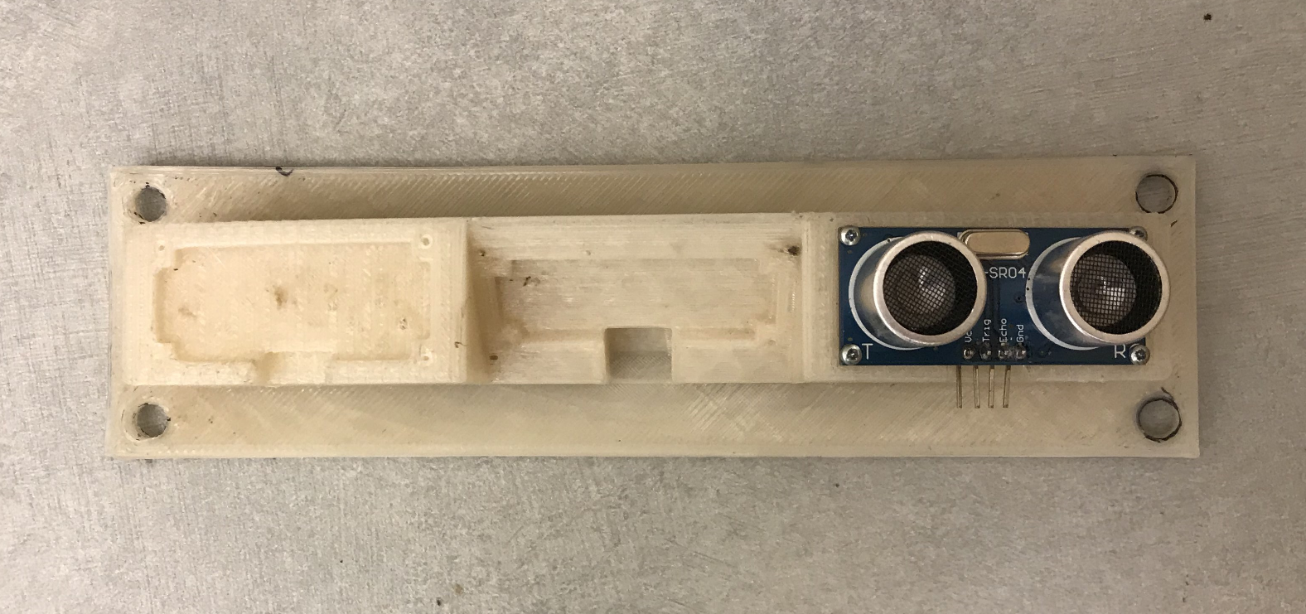
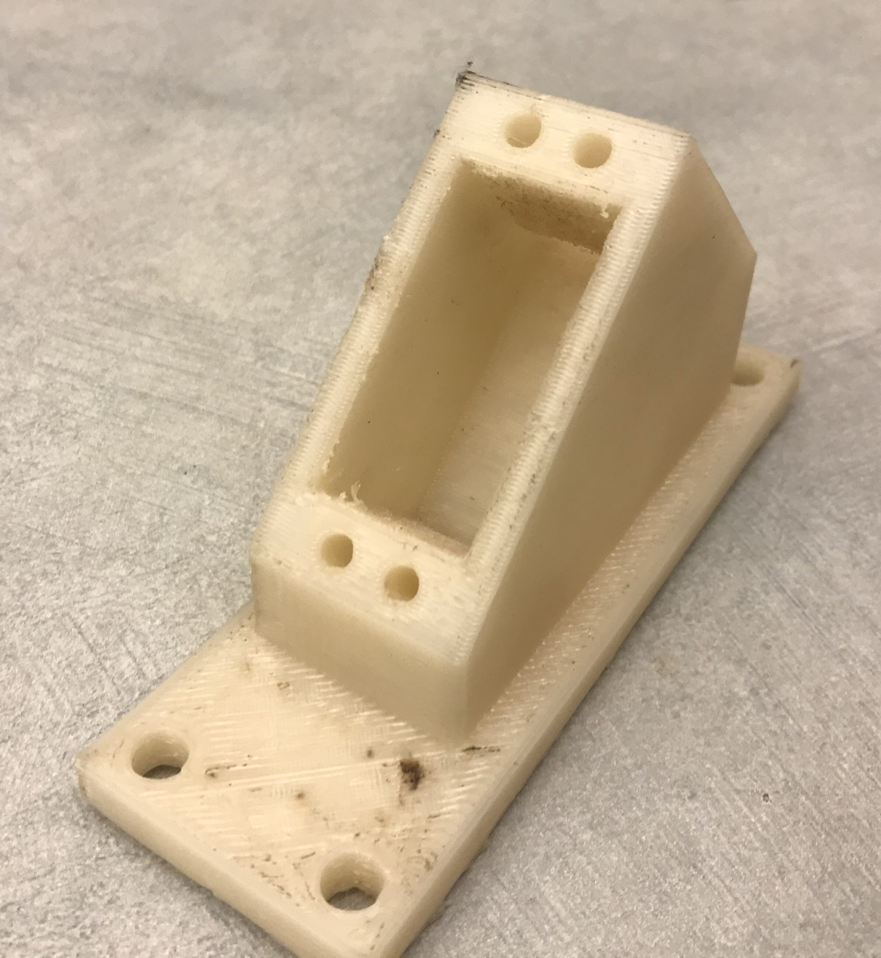
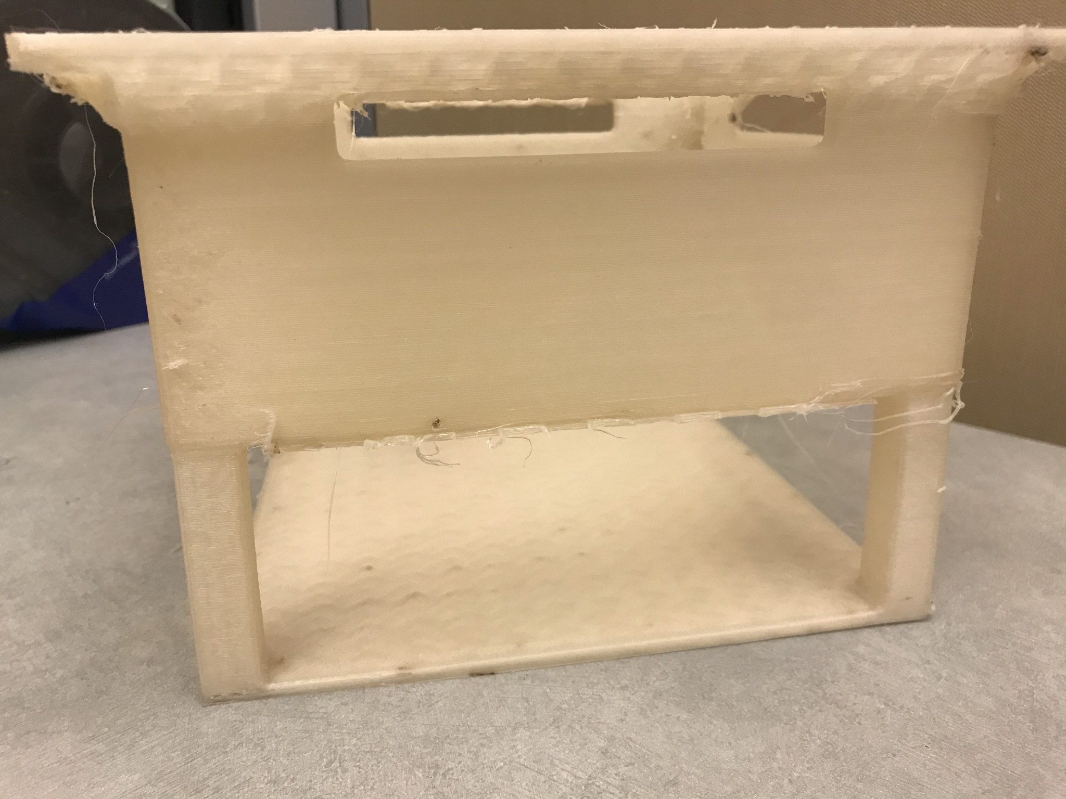
3D Printed Parts Meet Size Specifications
In Progress
Requirements: 3D printed parts must hold specified electronic components
9mm
22mm
46mm
4.2mm
59mm
29mm
60mm
Ultrasonic mount measured with calipers
155mm
Servo Bracket
measured with calipers
Gondola
measured with rulers
Conclusion: Ultrasonic mount, servo bracket, and gondola meet size specifications and should be able to hold required parts. Stress testing on the servo bracket needs to be done to insure structural integrity.

Slide 14

Component Mass is Within the Weight Budget
Complete
Requirement: System weight with payload should be <5N when filled with 4m³ of helium
The final estimate weight budget estimated that the system weight with helium would be 4.56N
The current actual weight budget shows the system weight with helium would be 3.44N which is 1.15N less then the estimated weight
Conclusion: The errors in the estimated weight budget average out giving an actual system weight of 3.44N which meets our technical requirement.

Slide 15
Software Design Subteam is Behind in Remote Controller Control
The following tasks will be presented in detail as forthcoming slides:
Milestones:
Noisy sensor readings in V-REP: Complete
Remote control
Servos and motors controlled by remote controller: Incomplete, in progress, expected 5/10
Delayed because of issues communicating with remote controller receiver, but was resolved
Currently working on remote controller positioning servos and motors for basic inputs (forwards/backwards, up/down, left/right)
Closed loop remote control is designed and tested in MATLAB: Complete
Closed loop Control Simulated in VREP: In Progress
Autonomous control
Servos and motors controlled autonomously: Incomplete
Delayed because of remote control implementation
Auxiliary functions (auto takeoff/landing and large pitch/roll) designed in MATLAB: Complete
Autonomous control expected in simulation, but physical testing is now a stretch goal: Late/Modified
Conclusion: Remote control is behind schedule but still expected to be done, but autonomous control is now only expected in simulation
Notes:
Raspberry Pi reads inputs from remote controller receiver using special protocol (SBUS)
Raspberry Pi forwards remote controller inputs to PIC32 to control servos and motors
PIC32 can control servos and motors simultaneously
Remote controller does not yet directly control servos and motors, currently trying to control servos and motors for three basic maneuvers (forwards/backwards, up/down, left/right)

Slide 16
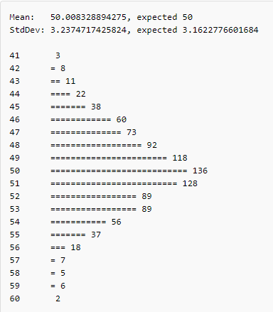
Noisy Sensor Readings Implemented into V-rep Simulation
Goal: Account for error within sensor data by implementing noise to simulate values a drone would actually find.
Provided a variance and mean, the function outputs a random number following the gaussian curve
Variance determined by data sheets with the following values:
Barometer : ± 0.4 kPa
GPS : ± 50m (CEP)
Ultrasonic : ± 3mm
IMU: ± 1.5%
Two standard deviations are recorded for each value meaning pseudo noise provides values 95% of time within the given values noise
The following output was made through a print function to show normal distribution working given the function and arguments: gaussian(mean - 50, variance - 10)
Conclusion: Noisy sensor readings output the values correctly within the range provided with the given a provided constraints. However, since this function utilizes a built in random function, all random outputs are essentially pseudo random.
Notes:
DIVIDE BY 2 and square the values to find variance

Slide 17
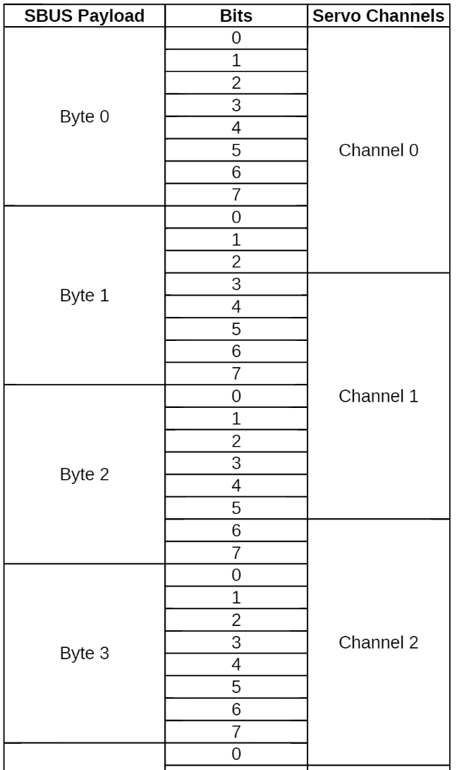
Remote Controller Receiver Protocol was Written for Raspberry Pi
Complete
Goal: Configure Raspberry Pi to read from remote controller receiver
Each input from remote controller is one channel to receiver
Throttle + yaw + pitch + roll + 4 switches + 2 dials = up to 10 channels
Potentially 10 different connections for 10 channel communication with remote controller
Receiver can use special protocol called SBUS (serial bus), an inverted UART signal, to send all inputs on a single line
Each SBUS payload is 1 byte, and each remote controller input is 11 bits, so a single remote controller input is broken up over 2 bytes
Conclusion: The remote controller receiver protocol has been written on the Raspberry Pi, and will be integrated into the system once the basic turning procedure has been implemented on the PIC32.
SBUS protocol for remote controller receiver

Slide 18
Remote Controlled Single Directional Flight is Currently Being Implemented on the PIC32
Incomplete, in progress, expected 5/10
Goal: Map remote controller inputs on the PIC32 to servos and motors for single directional flight
Before implementing multi-directional flight, single directional flight is being implemented (forwards/backwards, up/down, left/right)
Throttle, yaw, pitch, and roll commands from remote controller are values between -1 and 1 depending on remote controller stick direction and tilt amount
Throttle is routed to motor speed, but yaw, pitch, and roll need to be routed to servos
Conclusion: The procedure for remote controlled flight in a single direction is in progress, and must be done before multi-directional flight.

Slide 19
Remote Control System Design Overview
Requires Update
Requirement: Design a Closed Loop Remote Control System to respond to Remote Control inputs, that is within 0.1 radians from zero and a height of 1 ± .15 m.
The system requires several components to work, that are broken down over the next several slides
Pitch Roll Height Regulator to maintain stable system states
A command structure to interpret remote control commands and translate them into motor commands
A saturator to limit regulator outputs and remote control system commands
An overall system that combines all the previous components into a single RC system
Testing the system response to error and RC commands
Conclusion: RC system is fully designed in MATLAB and is being imported into VREP for detailed testing. Will also need to adjust values based on new drone specifications.

Slide 20
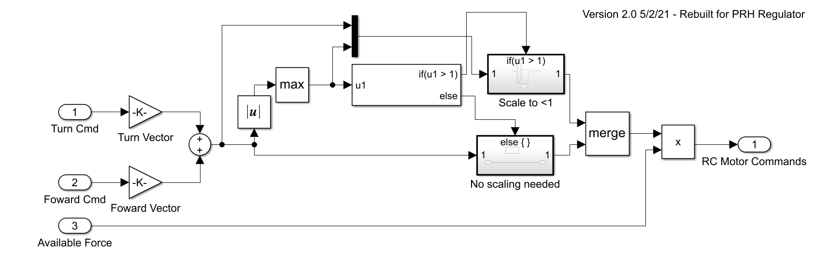
Open Loop Remote Control Command Designed to be Used in Conjunction with a State Regulator
Complete
Goal: Implement an open loop command system to interpret user commands.
Converts user commands to unscaled motor commands
Scales commands to be between -1 and 1
Scales output to available force
Conclusion: RC Open Loop is able to convert user commands to motor commands

Slide 21
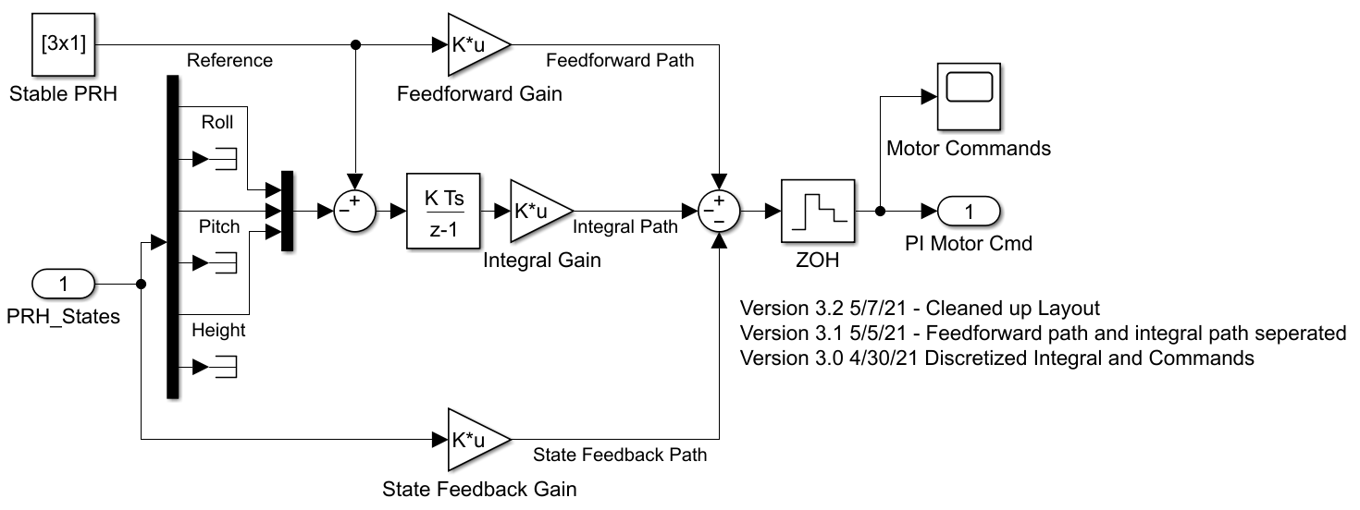
Pitch/Roll/Height Regulator Designed to Maintain Stability During Remote Control Flight
Complete
Task: Design a regulator to maintain stability of critical system states - pitch/roll/ and height
Conclusion: Applied full state feedback with an integral path to help the system maintain stability

Slide 22
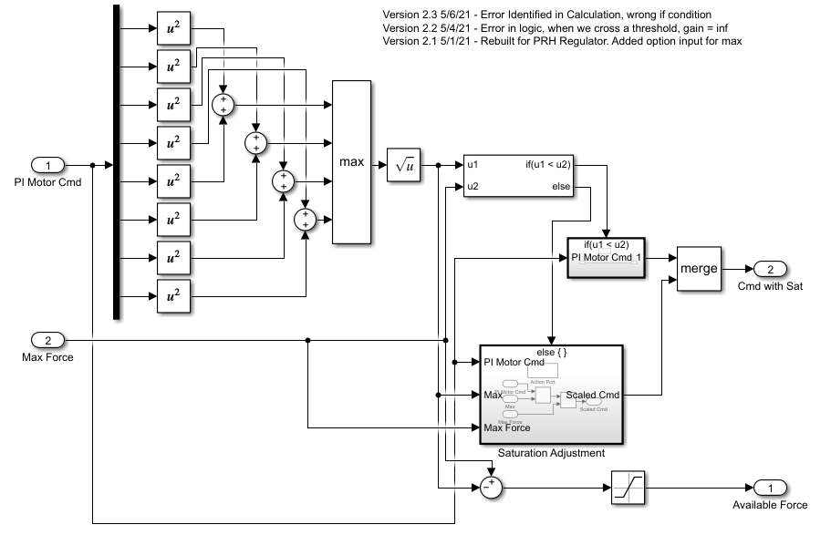
Saturator Designed to Limit Regulator Commands and Scale RC Commands
Complete
Goal: Take an input from the regulator and limit the outputs to the system max, while also returning force available to the RC system
Conclusion: The system combines X and Z components to be able to test motors max values and scales all commands equally.
Scales all commands to be within max motor range
Finds the largest motor command and returns it

Slide 23
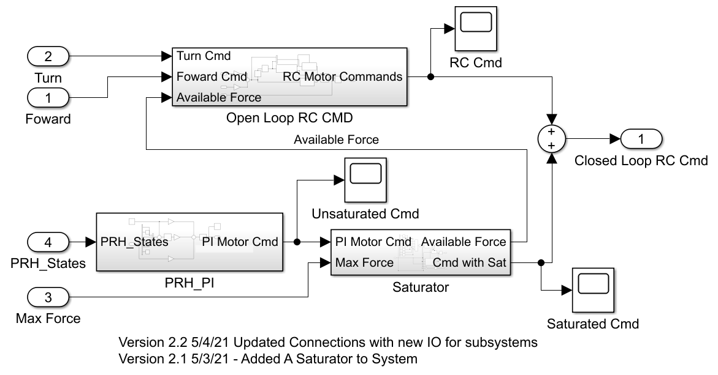
Regulator, Saturator, and Open Loop Systems Combined to Create Stable RC Controls
Complete
Task: Combine the regulator, saturator, and open loop systems to create a stable RC system
Conclusion: System is fully designed in MATLAB, but needs to be updated with new system specifications. System response shown on next two slides
Linear Combination of RC and regulator commands
RC Commands use “leftovers” from regulator. Non-essential for system stability

Slide 24
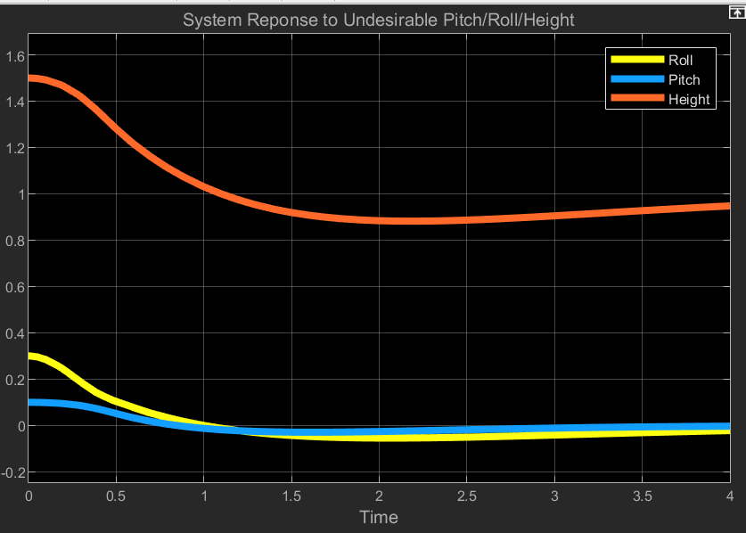
System Self Corrects Pitch Roll and Height within Requirements
Requirement: The system should return pitch and roll to an error of less than 0.1 radians and a height error of <15% in less than 1 second.
In this example, the height barely meets the overshoot requirement, but that slow response is partially due to large roll error.
Conclusion. Even with large errors, 0.5 meters and 0.3 radians, the system is able to return to stable conditions, but needs to be re-tuned for new specifications.
Fig. System Pitch/Roll/Height Response, with saturation block connected

Slide 25
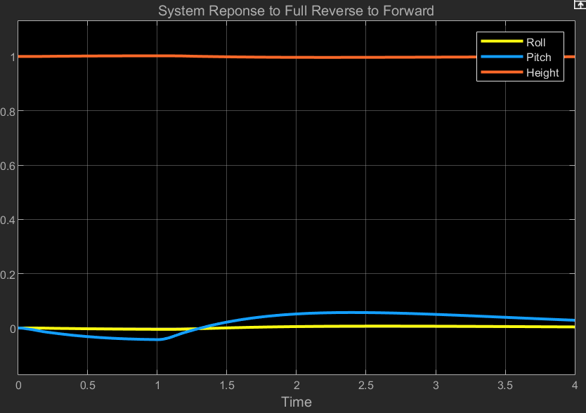
Regulator Maintains Stability In Worst-Case RC Command - Reverse to Full Forward
Task: Ensure the Regulator is able to maintain drone stability when given RC commands.
The worst case scenario for RC commands is going from full reverse to full forward, system response was tested at for this situation. Max pitch overshoot is about 0.06 radians, within the 0.1 radian limit.
Conclusion: The regulator is able to maintain stability with RC commands. The system is ready to be ready to be implemented in VREP.
Fig. System response when switching from full reverse to full forward at t = 1 second

Slide 26
End

